Slide 1
Let’s Talk
Always customer centric.
Always data lead.

Slide 2
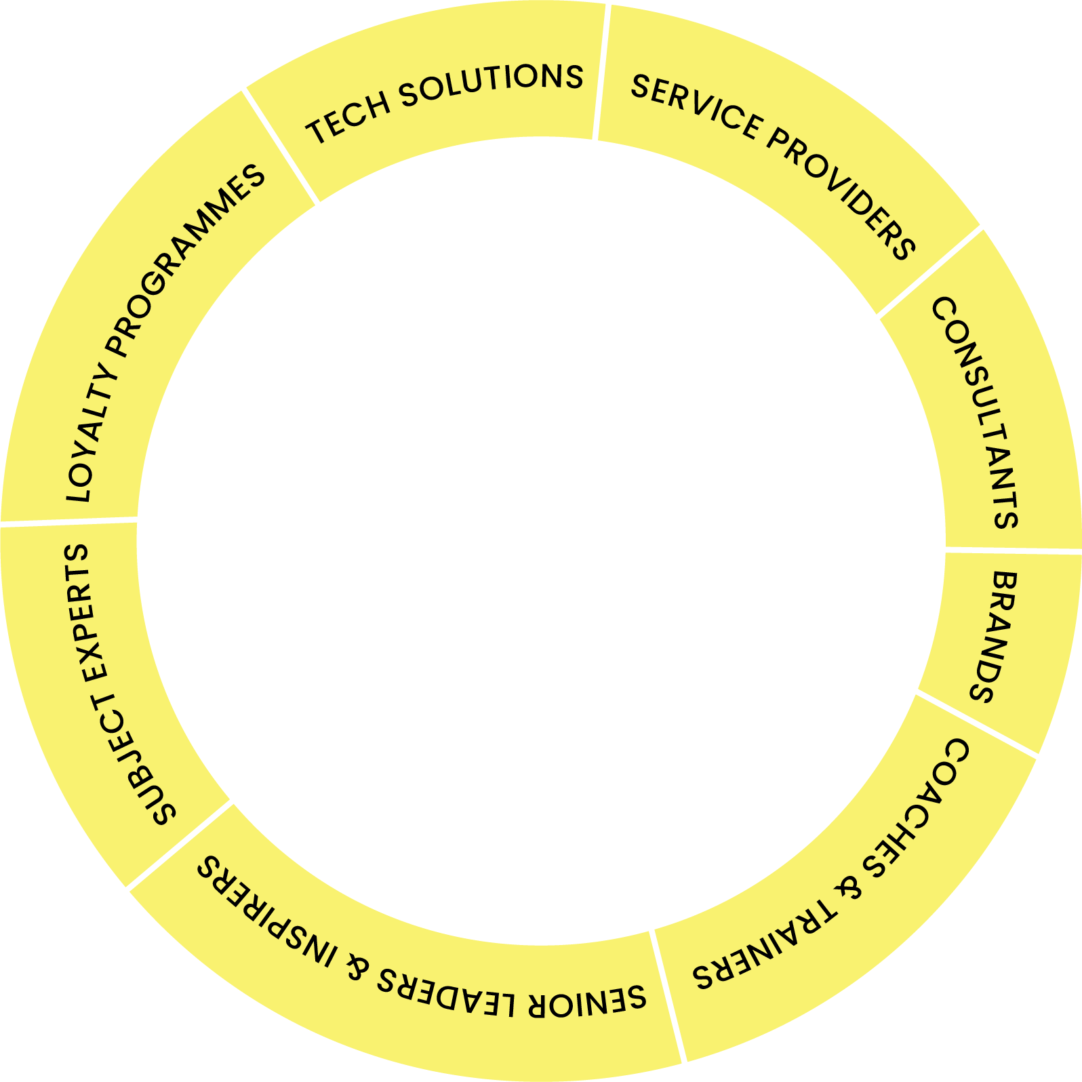
A global ecosystem of experts, laser focused on
loyalty, CRM & customer engagement

Slide 3
Welcome to The Loyalty People
Consult
Contract
Connect
We are experts in all aspects of Loyalty, Data and CRM. We are leaders in developing Customer Engagement
We offer an end to end solution from full strategic programme design through to project execution
We offer a flexible service model based on the needs of your business
We use our associate consultants to provide our clients with best in class expertise
Our associate consultants can be placed in your business to bolster your loyalty and CRM teams
Through our recruitment partners we can support placing individual expertise in your business permanently or on contract
We enable our partners to find talented individuals within our community and match them to new opportunities
We have a network of over 1500+ and growing fast, across LinkedIn and our TLP Community
We partner with best in class vendors in the Loyalty and CRM space to provide clients with end to end solutions
We provide up to date news, thought leadership, tools and our partner directory to make it easy for brands to get the latest and best insights

Slide 4
The Loyalty People services
Programme Innovation and Optimisation
Research
& Analytics
Tech Review & Recommendations
CRM Campaign
Design
CRM & Loyalty Strategy Design
Data Review
& Planning
Business Case
Build
Best In Class
Review

Slide 5
The Loyalty People’s flexible approach to strategic consulting
Discover
Design
Dabble
Deliver
We look at the market, we perform primary research and we get under the skin of your business to understand your customer needs
We formulate strategies, form hypothesis and build out actionable customer engagement strategies
We design concepts and MVPs, stress test hypothesis and build out business case assumptions with known data
We lead on execution, with your teams, building scalable solutions for as little or as long as you need us
Not just a strategy
but an implementation solution too

Slide 6
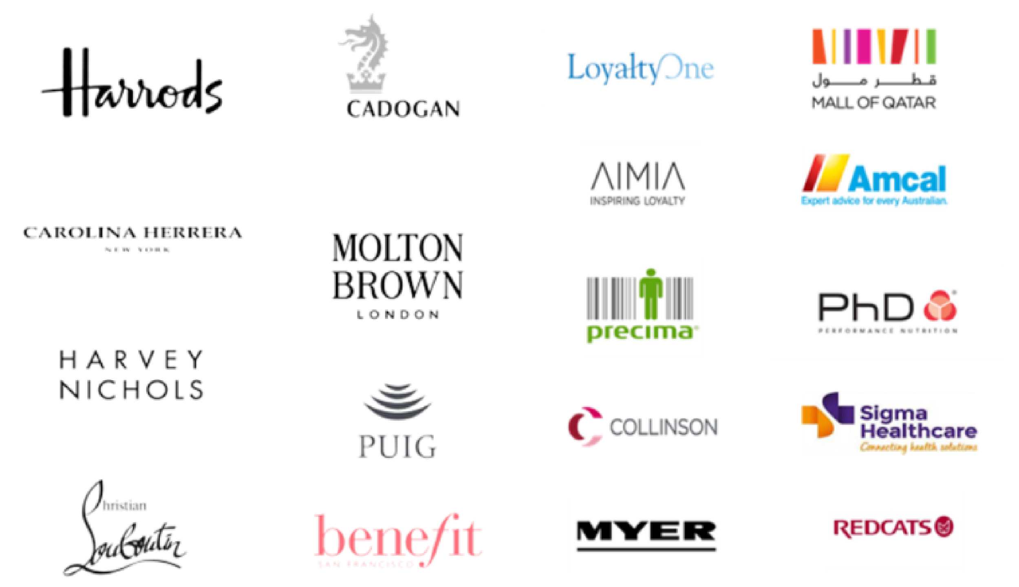
Brands we are proud to have worked
with

Slide 7
Why is emotional loyalty so important?
“Customers who are emotionally connected to a brand are 25% to 100% more valuable in terms of revenue and profitability than those who are merely satisfied with it.”
Harvard Business Review

Slide 8
CASE STUDY
The Story
Benefit wanted a proposition that was rewarding for customers, flexible from a cost perspective, that leaned towards ‘emotional’ loyalty.
The Solution
A new Loyalty proposition for the UK that drives Customer retention & Customer growth
Market review & best in class paper
Detailed proposition design with business case
Recommending the Tech provider with joint delivery plan
The Loyalty People’s wealth of knowledge and expertise is unparallelled. They became an extension of the team with their invaluable support and specialist knowledge. From an in depth research piece to a workshop, robust loyalty framework and business plan they have helped us to make an informed and considered leap into loyalty, allowing us to identify and unlock key opportunities
Carla, Senior CRM and Insights Manager, Benefit Cosmetics
Project
Loyalty Proposition
Services
Discover & Design / Market review / Loyalty design / Delivery plan
Industry
Beauty retail
Powered by

Slide 9
Don’t just take our word for it
“The Loyalty People instantly became part of the team bringing their considerable knowledge and experience to help us understand the opportunities open to us through effective CRM and loyalty, alongside practically driving the implementation of change.
Clearly motivated to help their clients succeed with the experience to make that happen, a first-rate partner to have on board.’’
Tony
Tony, Director of Marketing
We have always run a very customer focused business. But as times and technology change, we need to update the way we manage customer data, and find new ways to capture, understand and make best use of customer insights across our company.
Working with The Loyalty People means we can tap into the very latest thinking and expertise in this area, and provide our in-house team with an experienced and trusted ‘helping hand’ to achieve our goals.
Emily Mcinnis, Senior CRM Manager
The Loyalty People’s wealth of knowledge and expertise is unparralled. They became an extension of the team with their invaluable support and specialist knowledge. From an in depth research piece to a workshop, robust loyalty framework and business plan they have helped us to make an informed and considered leap into loyalty, allowing us to identify and unlock key opportunities. They are always on hand to support and I couldn’t be happier with the level of service they have provided.
Carla Raven, Head of CRM & Insight

Slide 10
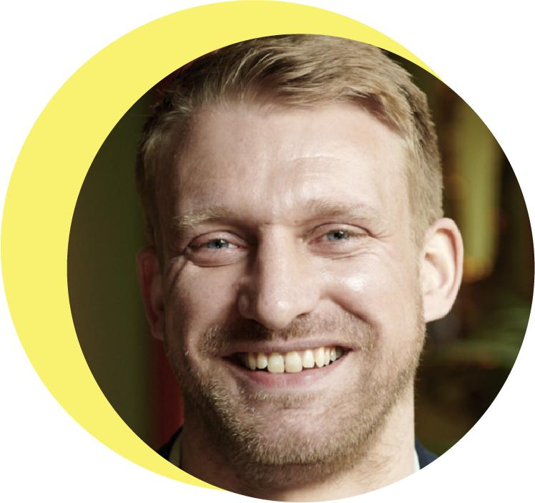
Meet the Executive Team
Pete Howroyd
Tom Peace
FOUNDER
CRO
Pete is a seasoned Loyalty executive and Founder of The Loyalty People, a successful Loyalty & CRM strategy agency offering global brands access to expert knowledge and resources. Prior to this Pete directed and grew many well-known loyalty programs internationally across fashion, pharmacy, and luxury industries
Tom has 15 years experience working at the forefront of the loyalty industry. He brings expert knowledge in all forms of customer loyalty including Financial Services, Retail, F&B, Travel and FMCG sectors. Tom's experience covers the latest trends in loyalty including “Paid-for loyalty”, Card-linking, real-time data analytics and emotional/experiential loyalty techniques

Slide 11
Let’s Talk
Soon
Tom Peace
tom@theloyaltypeople.com
+44 773 321 328
www.theloyaltypeople.com

