Slide 1
Always customer centric.
Always data lead.
Case Studies

Slide 2
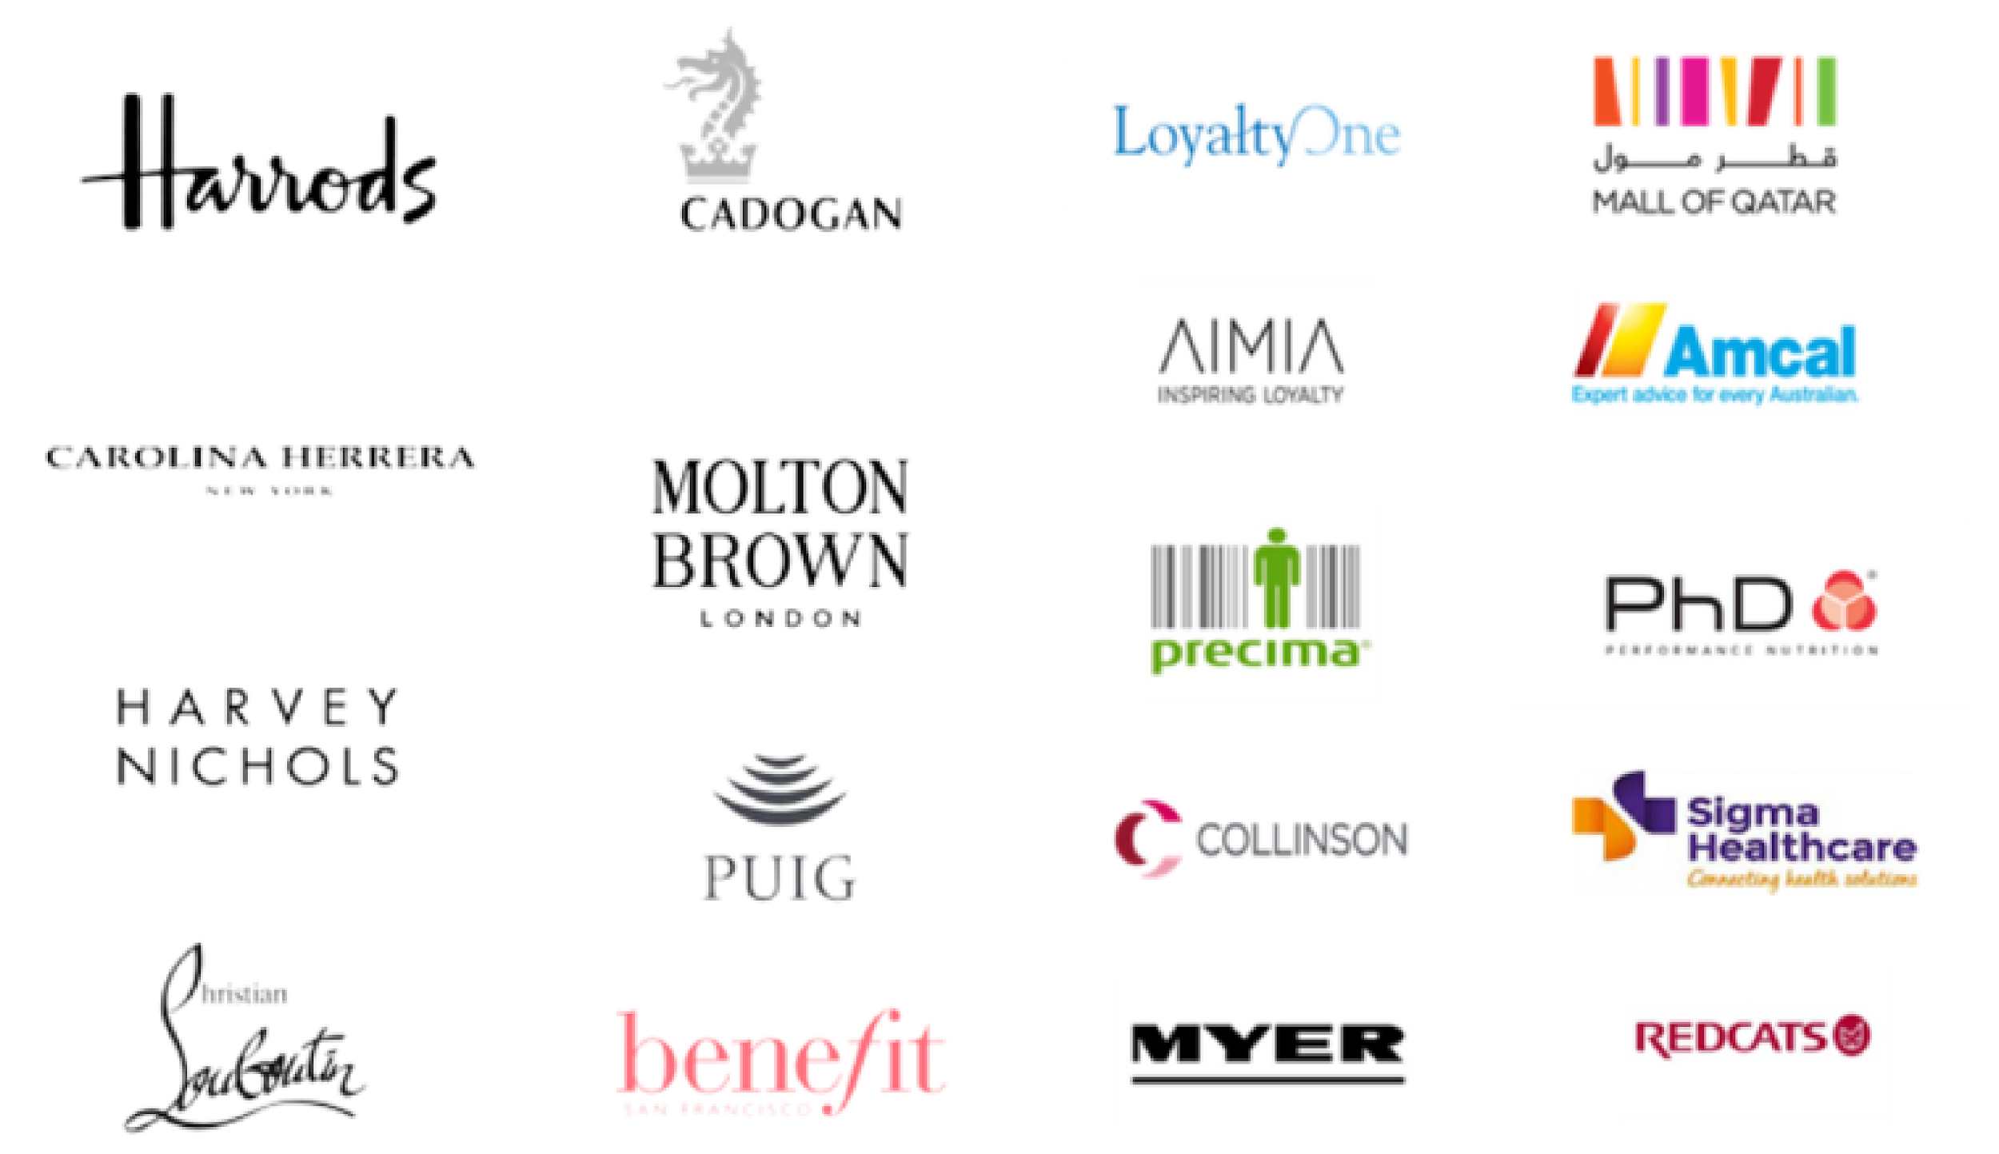
Brands we have already worked
with

Slide 3
CASE STUDY
The Story
Benefit wanted a proposition that was rewarding for customers, flexible from a cost perspective, that leaned towards ‘emotional’ loyalty.
The Solution
A new Loyalty proposition for the UK that drives Customer retention & Customer growth
Market review & best in class paper
Detailed proposition design with business case
Recommending the Tech provider with joint delivery plan
The Loyalty People’s wealth of knowledge and expertise is unparallelled. They became an extension of the team with their invaluable support and specialist knowledge. From an in depth research piece to a workshop, robust loyalty framework and business plan they have helped us to make an informed and considered leap into loyalty, allowing us to identify and unlock key opportunities
Carla, Senior CRM and Insights Manager, Benefit Cosmetics
Project
Loyalty Proposition
Services
Discover & Design / Market review / Loyalty design / Delivery plan
Industry
Beauty retail
Powered by

Slide 4
CASE STUDY
The Story
Mall of Qatar wanted a Loyalty proposition that rewarded spend across the retailers in the shopping mall
The Solution
A coalition Loyalty Strategy for the Mall of Qatar
Market review & best in class paper
Coalition loyalty strategy
Detailed business case
Project
Loyalty strategy
Services
Discover & Design / Market review / strategy & detailed business case / resourcing support for key roles
This was an in-depth loyalty design strategy working across a large number of retailers to deliver frequency and return visitation to the Mall of Qatar
Tom, MD, The Loyalty People
Industry
Retail
Powered by

Slide 5
CASE STUDY
The Story
Puig wanted a review of best in class CRM capability in the Beauty Sector and then a clear CRM strategy for two leading designer beauty brands- Christian Louboutin and Carolina Herrera, as well as a review of their Tech Stack and Data Architecture
The Solution
A CRM strategy for Christian Loubutin and Carolina Herrera
Market review & best in class paper
CRM strategy with recommeded campaigns
Data briefs and review of data architecture
Project
CRM Strategy
Services
Discover and Design Phase / Market review / CRM Strategy / CRM Data Brief and Trigger Campaign Design
This project is now moving into a ‘Dabble’ phase to build a test of CRM with the Global Puig Team
Tom, MD, The Loyalty People
Industry
Beauty Retail

Slide 6
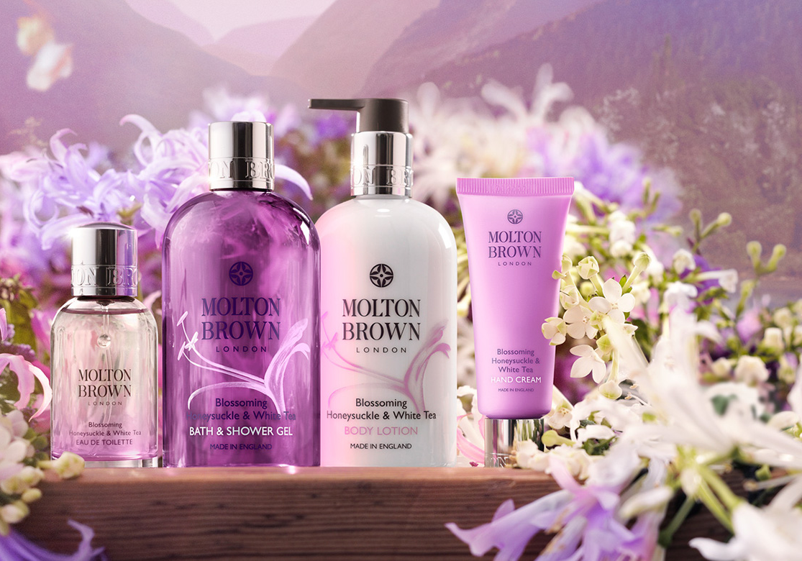
CASE STUDY
The Story
Molton Brown wanted a better understanding of their Customer Data
The Solution
An analytics and insight project to support Molton Brown with a better understanding of their customers
Monthly Report creation
Customer Lifetime Value
Acquisition Analysis
Project
Analytics and Insight
Services
Building Reporting / Acquisition Review / Customer Value Analysis/ Customer Lifetime Value
We have always run a very customer focused business. But as times and technology change, we need to update the way we manage customer data, and find new ways to capture understand and make best use of customer insights across our company. Working with The Loyalty People means we can tap into the very latest thinking and expertise in this area and provide our in-house team with an experienced and trusted ‘helping hand’ to achieve our goals.
Emily, Senior CRM Manager, Molton Brown
Industry
Beauty Retail

Slide 7
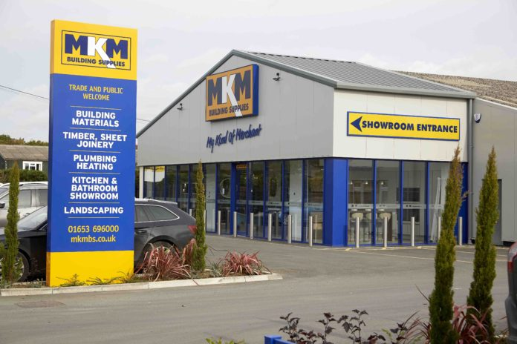
CASE STUDY
The Story
MKM Building Supplies wanted to fully review their CRM strategy and technical capabilities. Alongside this we build out a test and learn ‘dabble’ phase with full analysis of results and recommended next steps
The Solution
A full review of CRM strategy and infrastructure
Full CRM Review
CRM Strategy
Reporting and Data Analysis
Project
CRM Strategy
Services
Review of current strategy / CRM Infrastructure review / test and learn campaign design / analysis
The Loyalty People instantly became part of the team, bringing their considerable knowledge and experience to help us understand the opportunities open to us through effective CRM and Loyalty, alongside practically driving the implementation of change. Clearly motivated to help their clients succeed with the experience to make that happen, a first-rate partner to have on board.
Tony, Director of Marketing, MKM Building Supplies
Industry
DIY and Home Retail

Slide 8
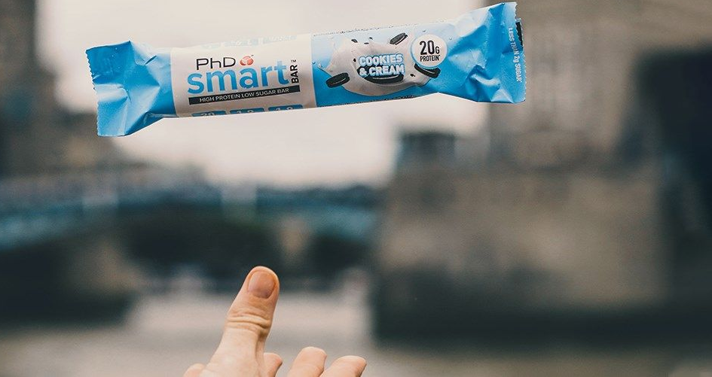
CASE STUDY
The Story
PHD SIS wanted to build a real-time customer data store, with static customer segmentation to understand their customers better. Alongside this they wanted to build customer personas to help with targeting and CRM
The Solution
A Data Segmentation and Customer Personas
Full Data Review
Customer Personas
Customer Segmentation
Project
Data Segmentation and Customer Persona
Services
Review of current Data / Static Segmentation / Customer Personas
Being able to support businesses with a better understanding of their customer data, structuring it correctly and being able to build actionable strategies to improve relevance and targeting is a key deliverable at The Loyalty People. It was key to the ongoing Customer Strategy at PHD SIS to create personas that could be matched in the data and behaviours to enhance their CRM.
Tom, Managing Director, The Loyalty People
Industry
Health and Fitness Retail

Slide 9
Let’s Talk
Soon
Tom Peace
tom@theloyaltypeople.co.uk
+44 773 321 328
www.theloyaltypeople.co.uk

